Slide 1
ICPI Tableau Training
A DIV & DAQ Collaboration
June 21, 2018
Logistics
Wifi password
Download & open Training materials:
demo, practice file, dataset

Slide 2
Welcome to the ICPI Tableau Training!
Login to wifi
Download & open Training materials:
dataset
demo
practice file
Additional resources
Code for reshaping dataset

Slide 3
Section timing = 10min

Slide 4
Who are we, and who are you?
Name
Agency
What is one thing you struggle with when it comes to creating graphs, presenting data/information in a visual format?
Notes:
Ask participants to state their name, agency, and one struggle with presenting data.
Record responses, and note points where struggles can be overcome with Tableau or where appropriate, other software given the issue.
“Through this training, we hope to highlight a few ways you can overcome these struggles using Tableau or another software where appropriate”
Relate to training objectives

Slide 5
Section timing = 10min

Slide 6
Pre-training Assessment
Majority are:
Beginners
Use Excel to visualize data (some use R, Tableau, ArcGIS/QGIS, few use other software)
Want to learn…
Restructure data for Tableau
Import and work with MER datasets
Create basic to advanced visualizations
GIS functions in Tableau
Capabilities/software solutions
Notes:
Based on the assessment results., we hope to address some of the interests and needs in learning to use Tableau for PEPFAR analyses.
We’ll cover majority of these points, but some items will not be

Slide 7
Training Objectives
Pre-training Assessment
Majority are:
Beginners
Use Excel to visualize data (some use R, Tableau, ArcGIS/QGIS, few use other software)
Want to learn…
Restructure data for Tableau
Import and work with MER datasets
Create basic to advanced visualizations
GIS functions in Tableau
Capabilities/software solutions
Recognize when Tableau is an appropriate software to use and when it may not be
Analyze and develop visualizations of PEPFAR data in Tableau
Notes:
Based on the assessment results., we hope to address some of the interests and needs in learning to use Tableau for PEPFAR analyses.

Slide 8
Training Objectives
Recognize when Tableau is an appropriate software to use and when it may not be
Analyze and develop visualizations of PEPFAR data in Tableau
Notes:
Based on the assessment results., we hope to address some of the interests and needs in learning to use Tableau for PEPFAR analyses.

Slide 9
Overview
Overview of visualization software
Demo: building a visual in Tableau
Practice
Resources
Discussion/Q&A
Wrap-up
Notes:
Outline of 3 hour training session

Slide 10
Visualization software
Notes:
Most people here use Excel, some use R, Tableau and GIS software. Few use other software including stats

Slide 11
Overview of Visualization software
Help on this slide, please!
Task | R | Tableau | Excel | ArcGIS/ QGIS | Analytic Workspaces
Subset data
Manage and join multiple data sources
Dynamic visualizations
Custom maps
Tooltips with visualizations
Sharing
Notes:
What software is best suited for which task, should we include learning curve with this too? Is this overkill?

Slide 12
When should I use Tableau?
Polished visual, quickly
Merging multiple datasets
Connecting to various datasources/ databases
Dynamic visualizations
Exploratory review of data
Large datasets
But…keep in mind:
Audience access to open Tableau files (Tableau Reader and version)
Bottom line: depends on the task at hand and what you’re comfortable with

Slide 13
Section timing = 10min

Slide 14
Tableau showcase
Help on this info, please!
Josh
Noah
Kristy
Peace Corps – OGHH dash, PSRs
Prevention Ref Tables
Notes:
10 min tops to show 1-2 examples of what people have done with Tableau, other examples can be included in Resources for participants to access later

Slide 15
Section timing = 45min

Slide 16
Demo time!
Make sure you have downloaded & opened the training materials

Slide 17
Demo time!
Features
Filters
Marks card
Tooltips
Viewdata
Demo 1: Getting your data in (30 min)
Import Datasets
Note dimensions/measures - did everything pull in correctly?
Create a Tableau data extract
Save workbook
Demo 2: Organizing your data (30 min)
Review Dimensions & Measures
Grouping indicators by technical area
Create simple calculated field
Create basic table
Demo 3: Visualizing your data (30 min)
Create set of 3 visuals
Put together a dashboard
QC visuals - duplicate as cross-tabs and QC against pano or another source
Notes:
Highlight features that can be replicated in other software, such as R, Stata, Excel, SAS…but also can be done in Tableau. Depends on what you’re comfortable with and on the task at hand.

Slide 18
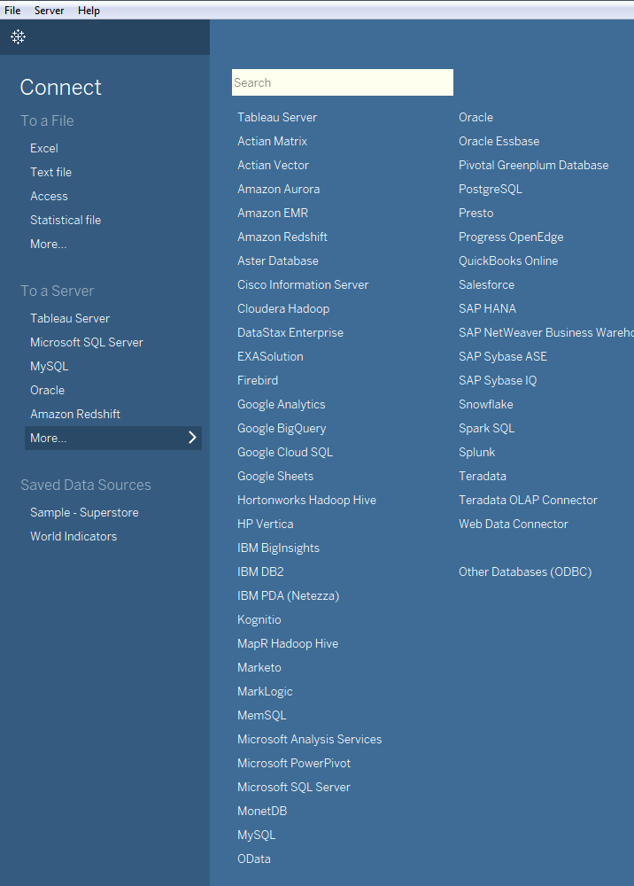
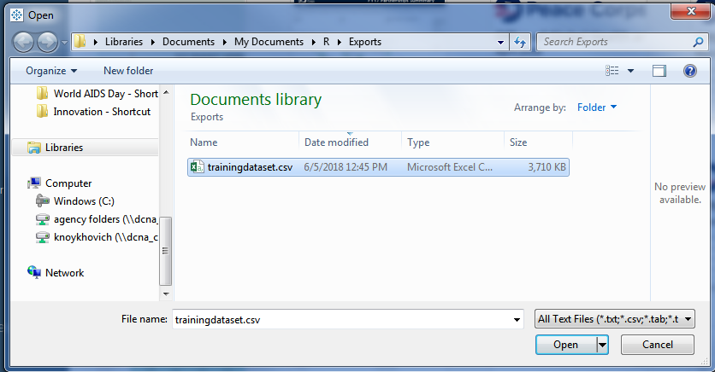
Connect to your data source

Slide 19
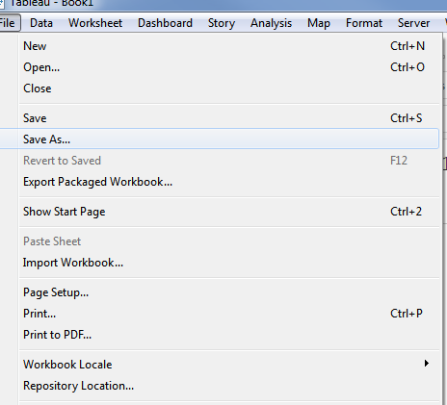
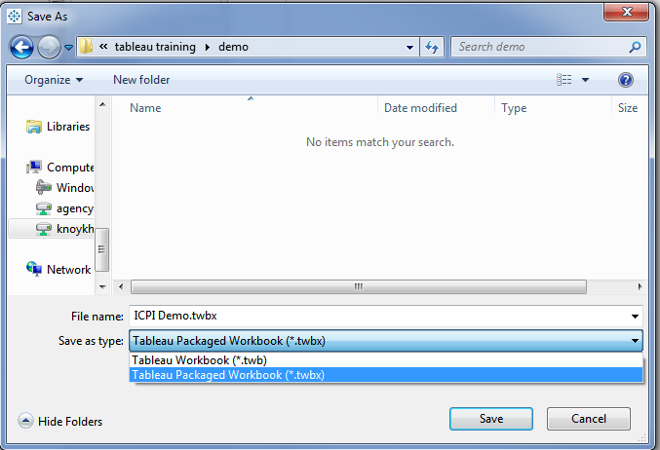
Save your workbook

Slide 20
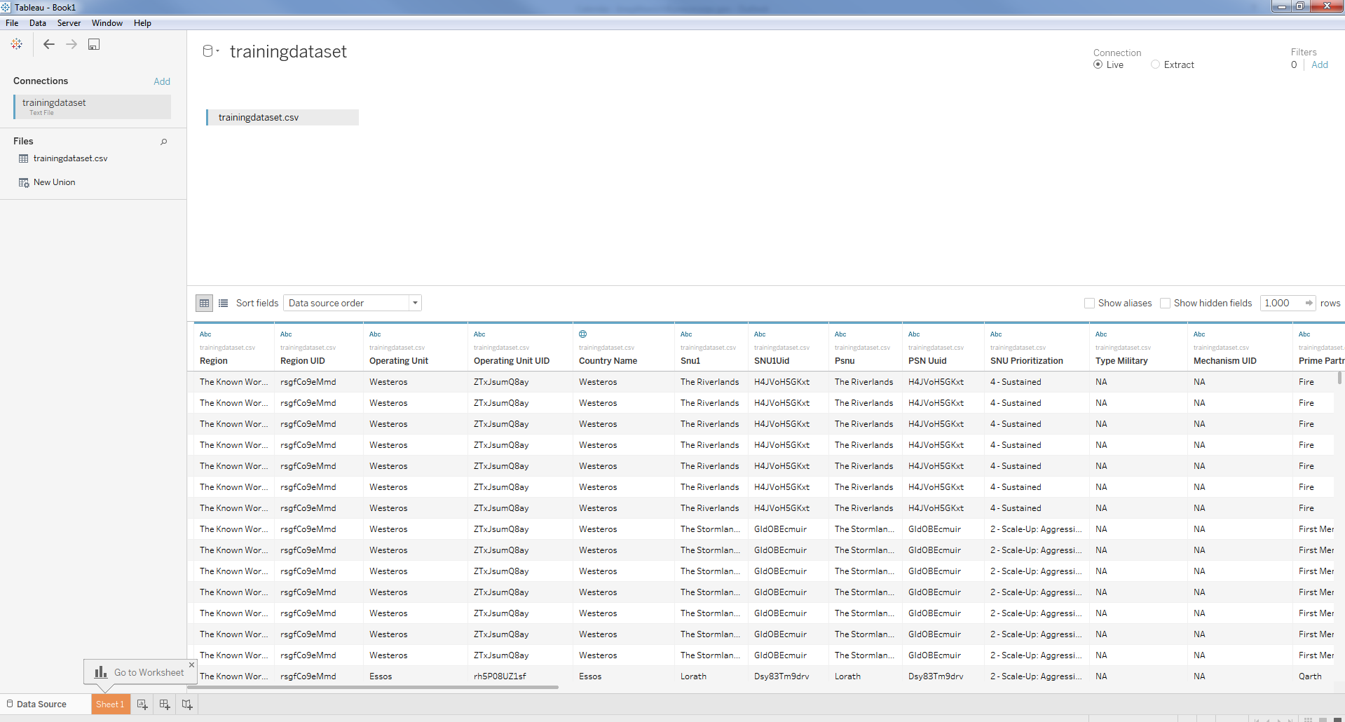
Examine your data source
This is the data source name
Live connection or Extract? Think of Extract as subsetting a datasource within Tableau to improve speed with running visuals.
This is the sheet (if using a csv/xls file) that is pulled into Tableau
Note the column headings below

Slide 21
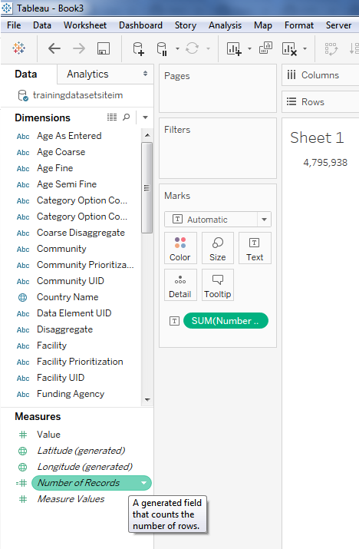
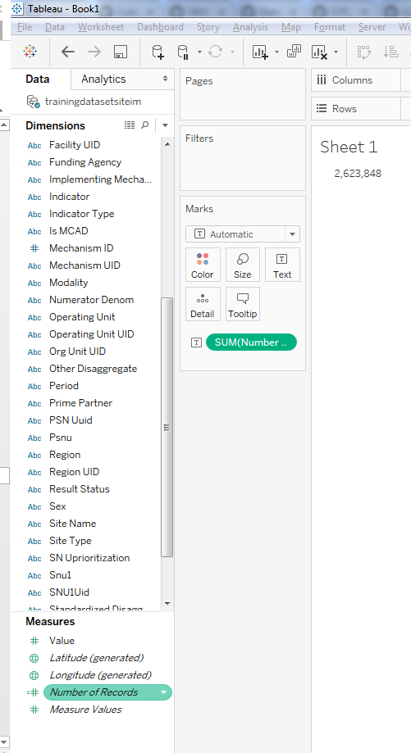
How many rows did I import?
Before Extract
After Extract

Slide 22

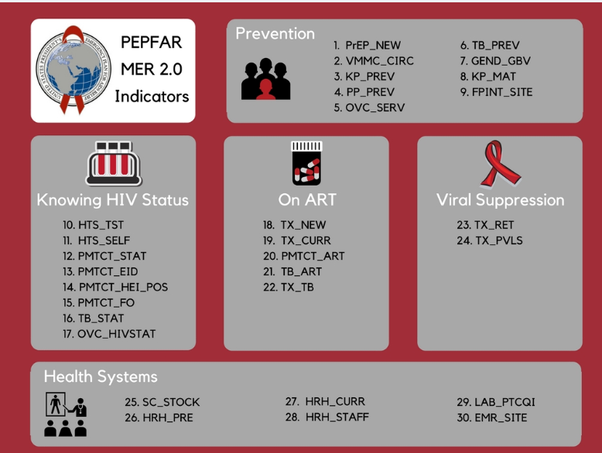
Extract your Tableau data file for speed!
Extract to include these indicators

Slide 23
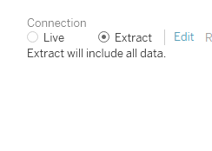
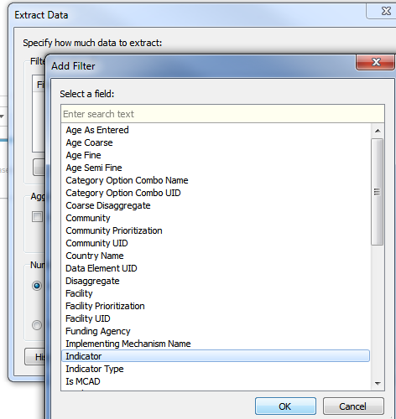
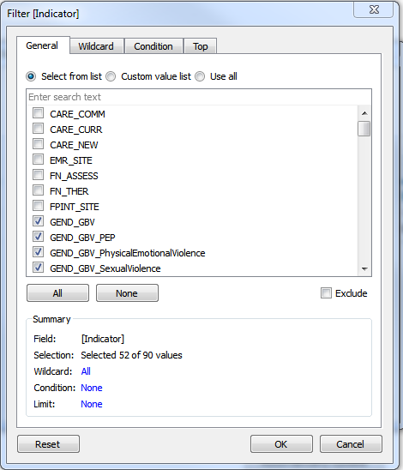
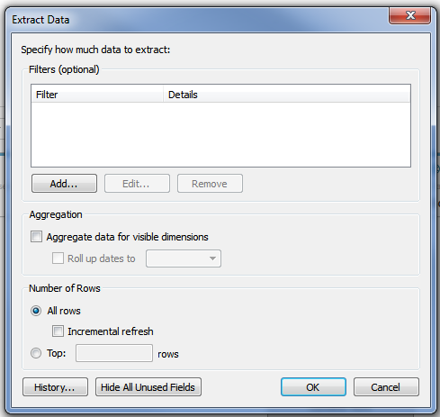
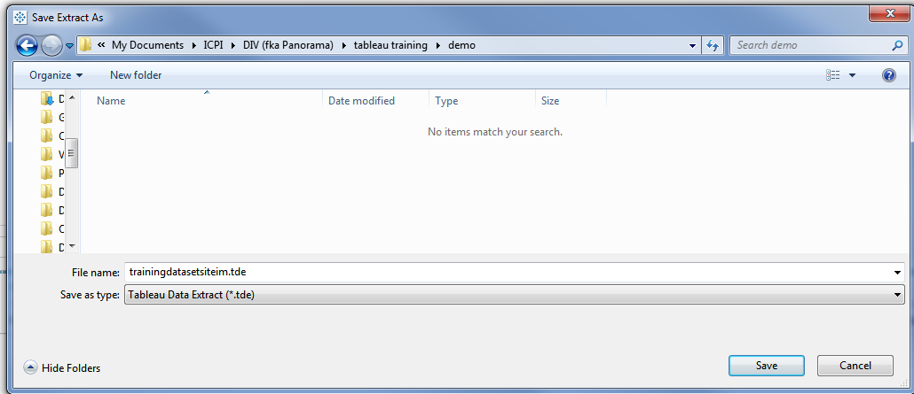
Extract your Tableau data file for speed!
1
2
5
3
4
6
7

Slide 24
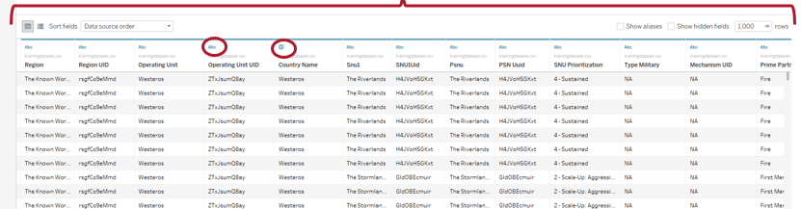
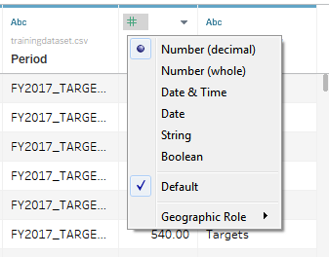
Examine your data source
Note the column headings below
Each variable gets pulled in and categorized by type of data: number, date, string, etc.
You can edit the type of data a variable is by click on the “Abc” or # or
You can also edit the type of variable by clicking on metadata

Slide 25
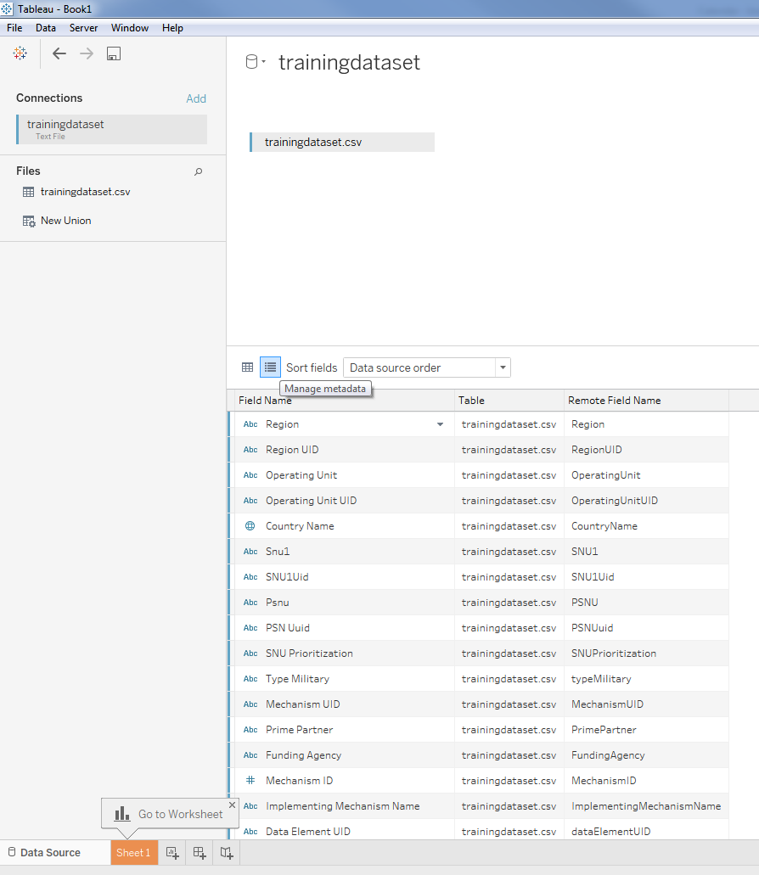
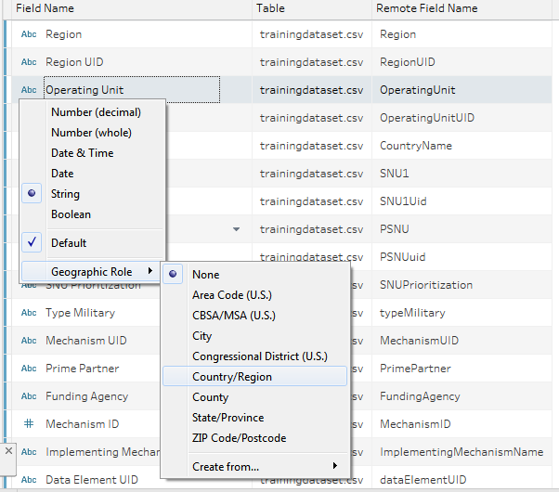
Examine meta data
Here you can also view and edit the types of variables in your dataset

Slide 26
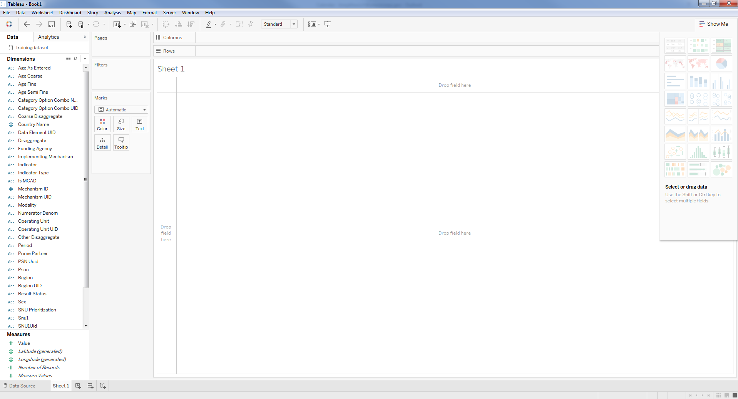
Orientation to interface
Think of it as a pivot table in dragging variables to rows & columns
Your Data source is here
Note - Filters
Marks – lets you customize a visual by applying colors, size, labels, tooltips, shapes, etc.
Sample visuals. Hover over and see the tips on how to create this. Good place to start to explore your data
Dimensions
Measures

Slide 27
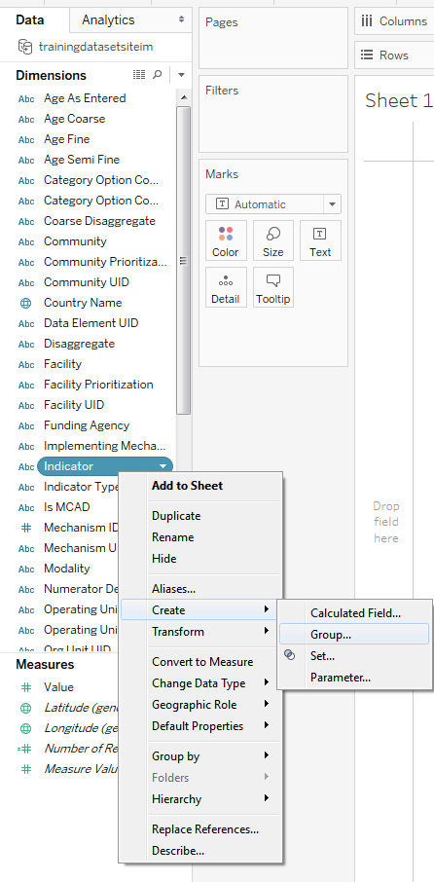
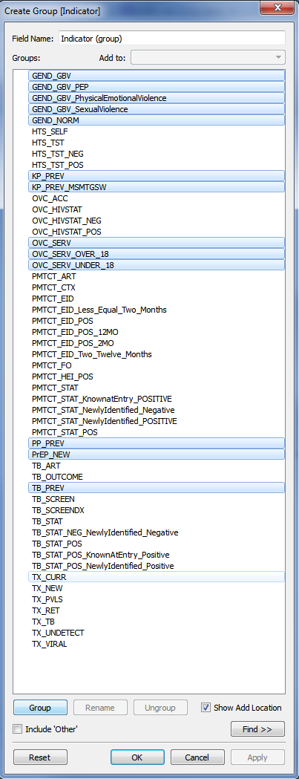
Organize your data: group indicators by program area

Slide 28
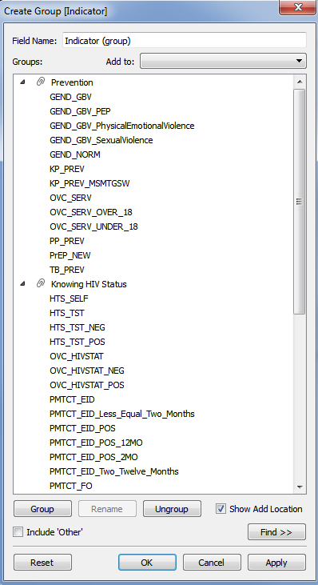
Grouped indicators

Slide 29
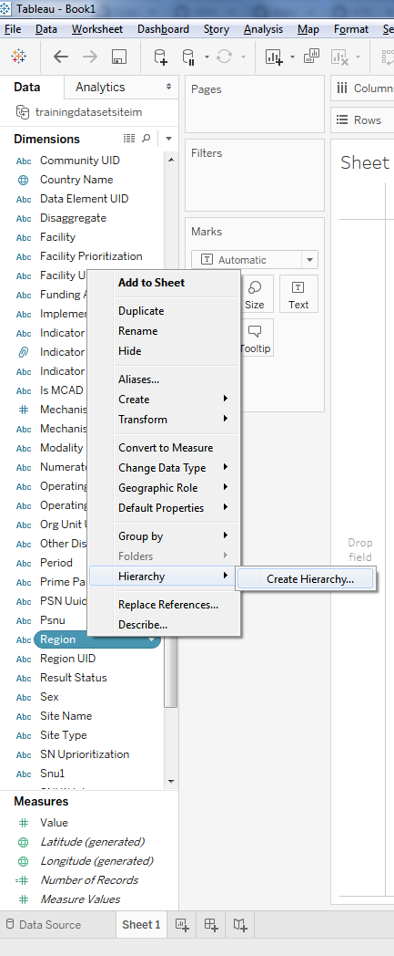
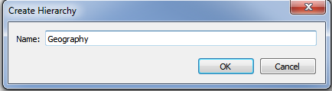
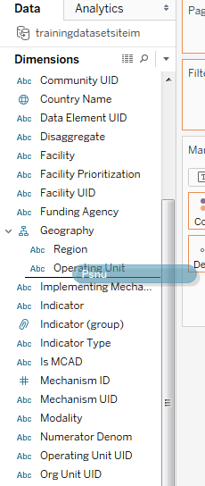
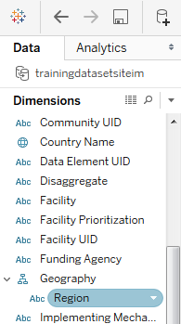
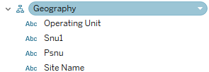
Organize your data: create hierarchy for geography
2
Drag & drop!
3
1

Slide 30
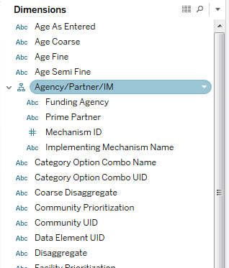
Organize your data: create hierarchy for agency/partner/im

Slide 31
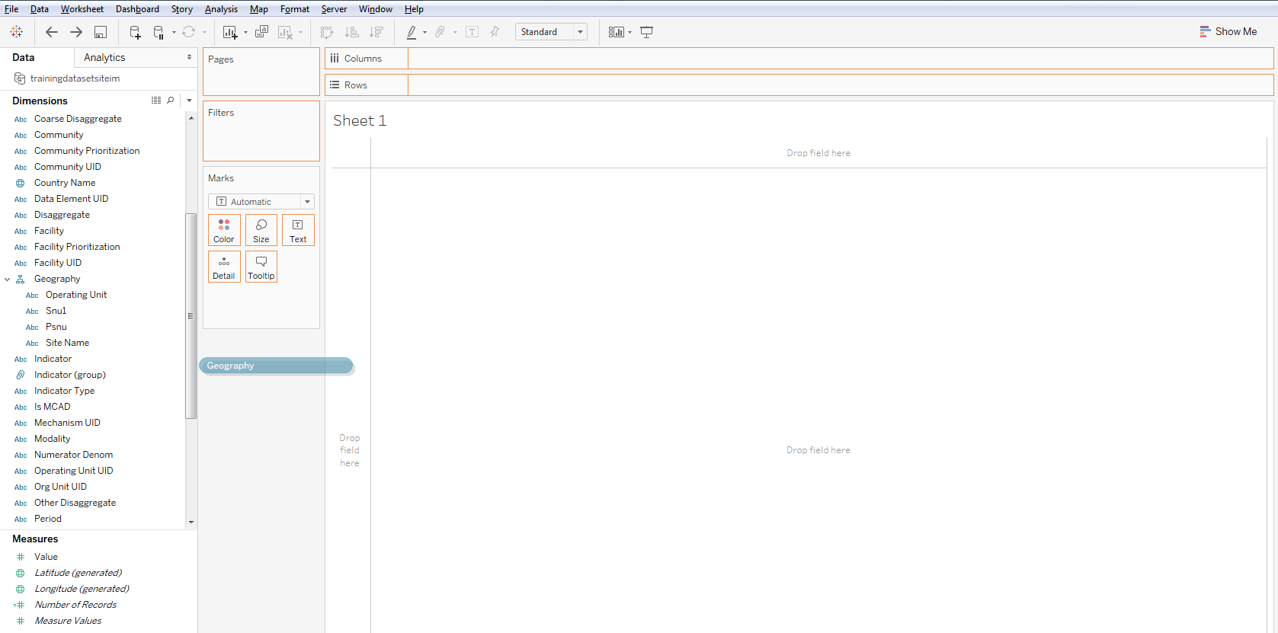
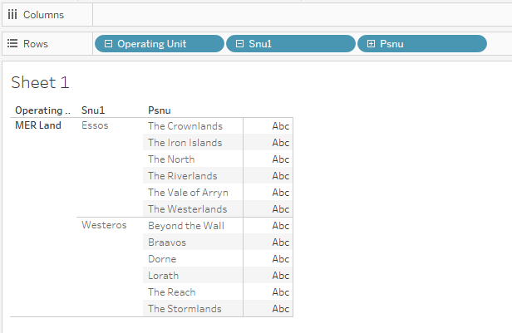
Build a basic table – 1
Drag & drop Geography to Rows
Drill down to PSNU

Slide 32
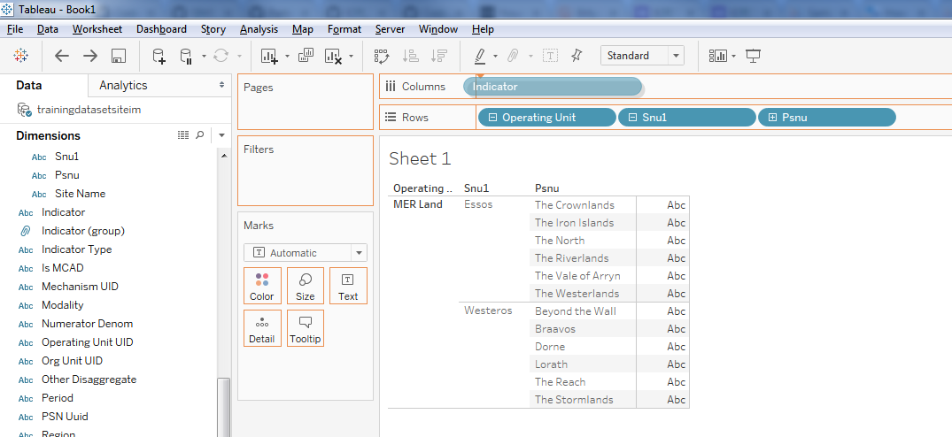
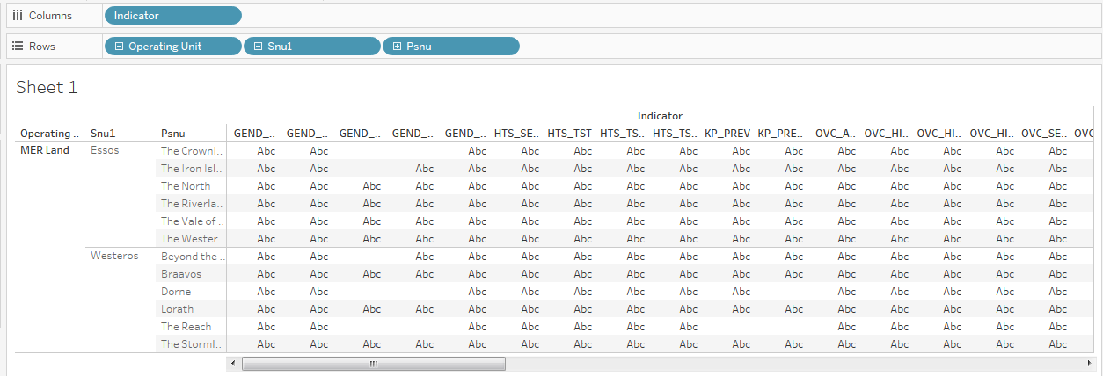
Build a basic table - 2
Drag & drop Indicator to Columns

Slide 33
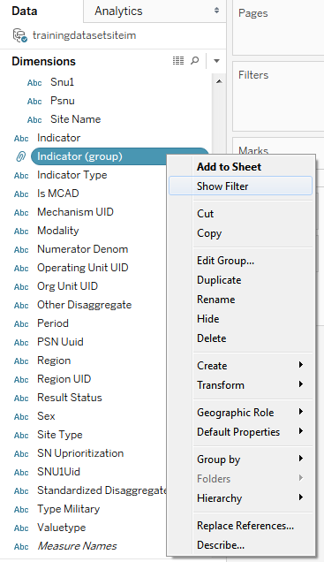
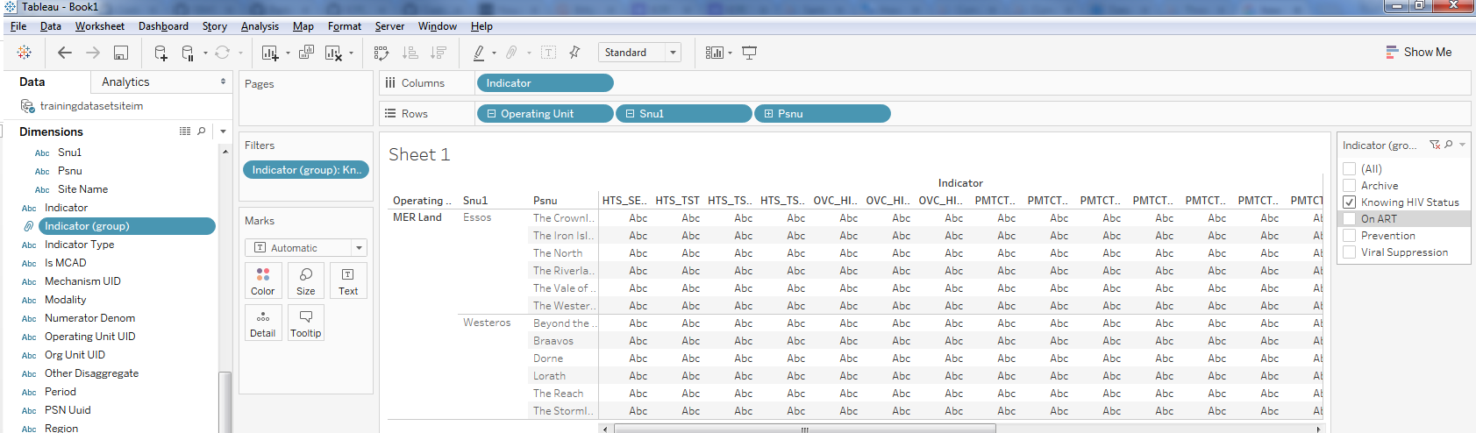
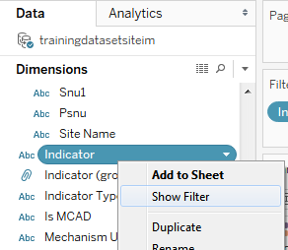

Build a basic table - 3
Create a filter for Indicator (group)
Oh my! Lots of indicators
Don’t worry, my friend! We can edit our indicator group or create a new one.

Slide 34
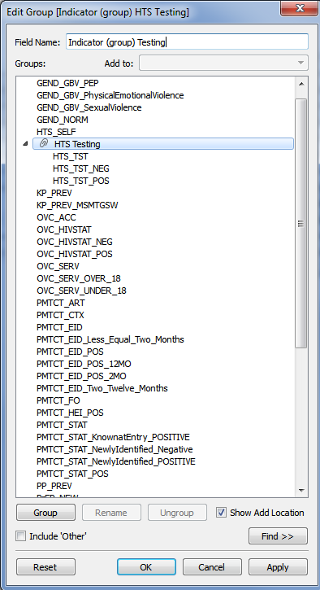
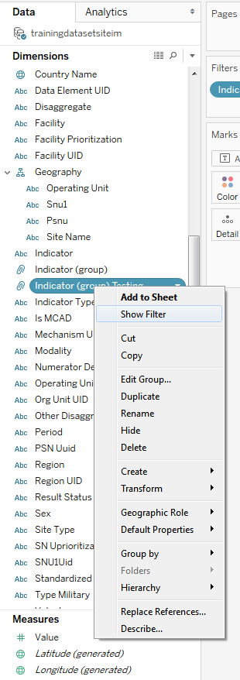
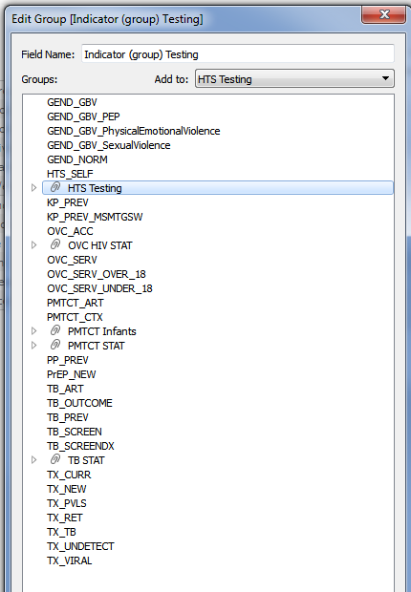
Build a basic table - 4
Create New Indicator Group for a subgroup of testing indicators & add as filter

Slide 35
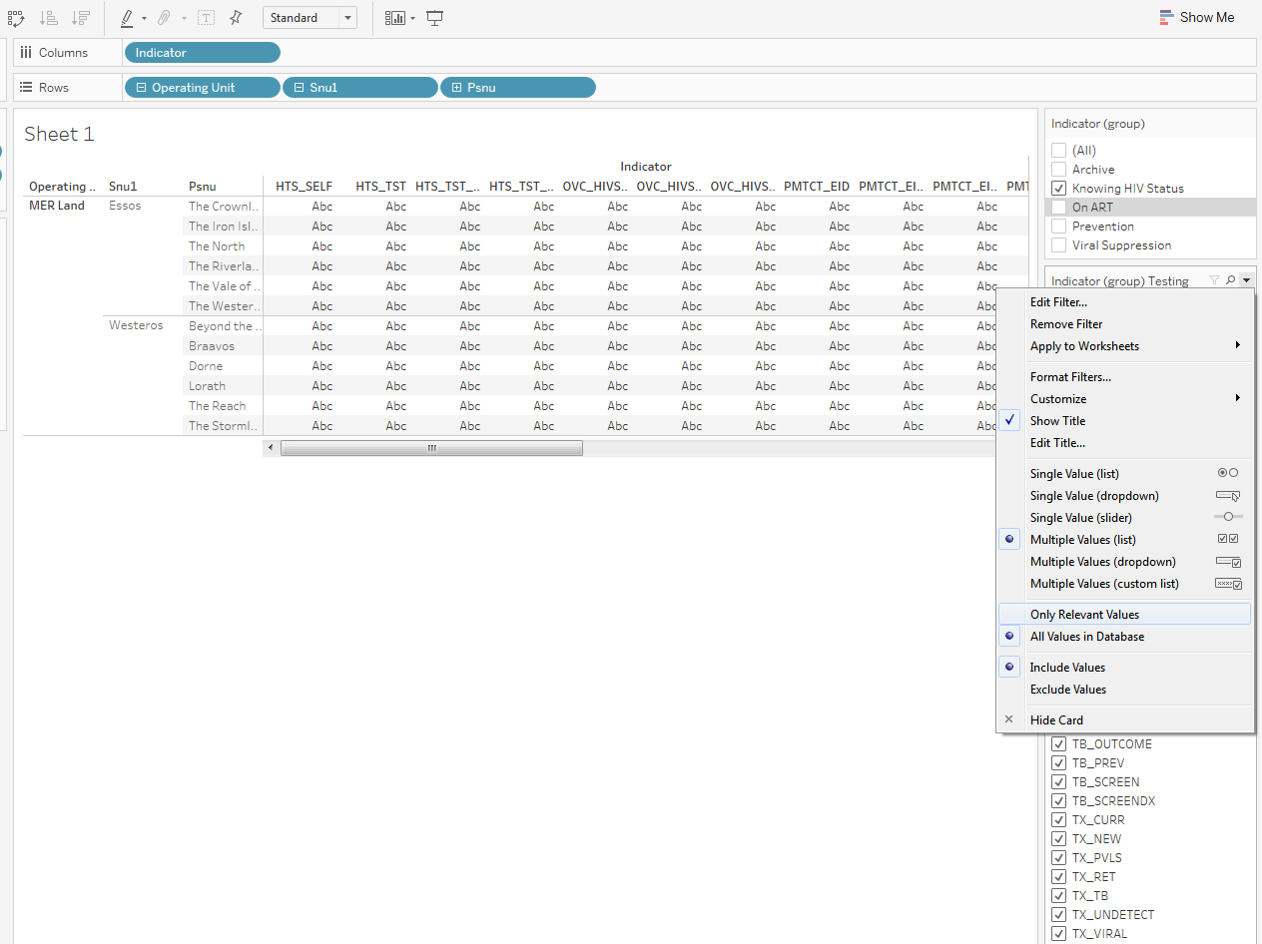
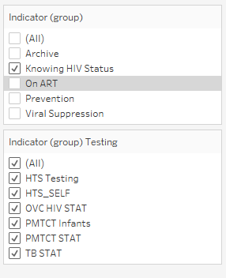
Build a basic table - 5
Apply the grouping filter to the secondary filter to include “Only Relevant values”

Slide 36

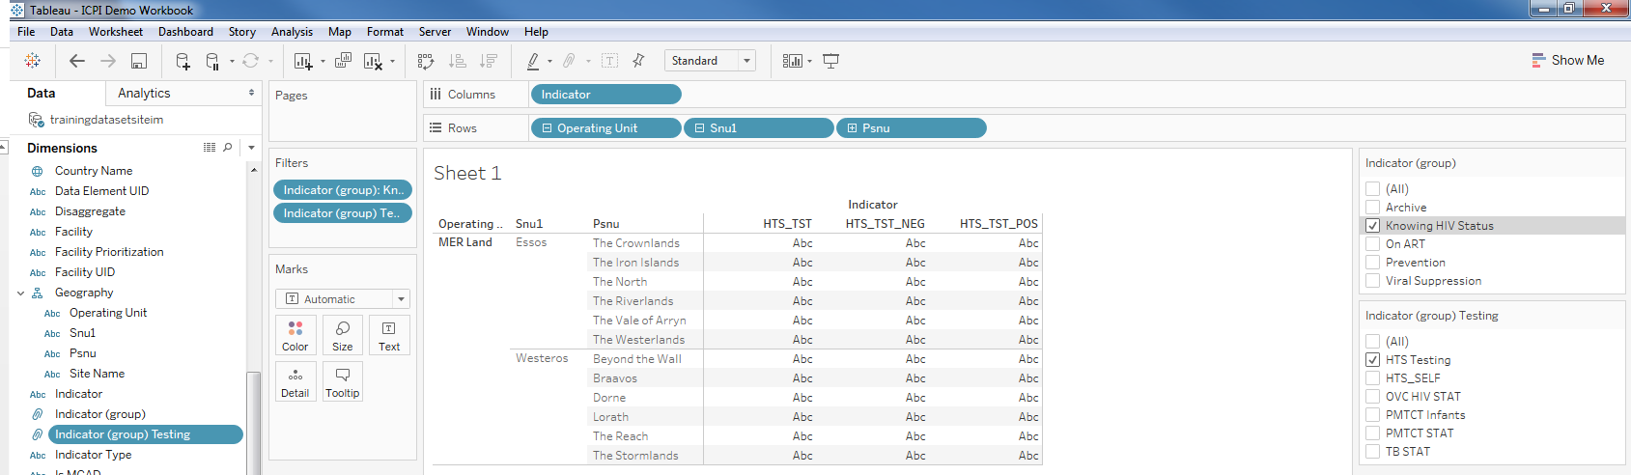
Build a basic table - 6
Check your view

Slide 37

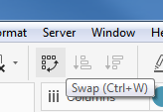
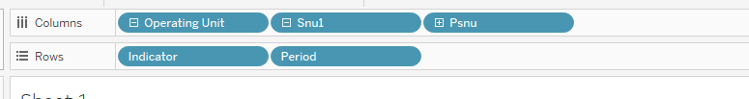
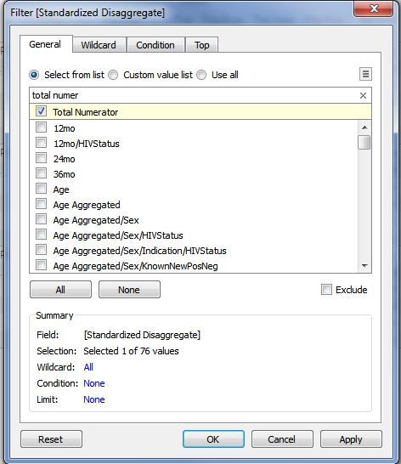
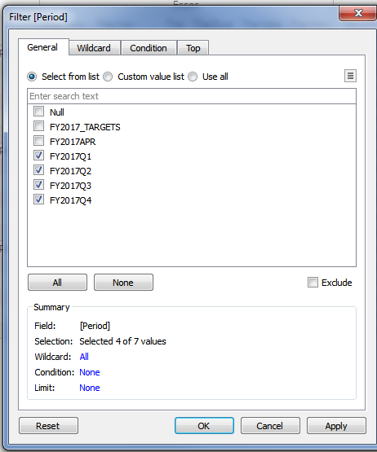
Build a basic table - 7
Check your data by dragging in dimensions you’ve set to filters, or other variables like “Numerator Denom”
Drag period to Columns after indicator
Swap rows & columns
Standardized disaggregate → filter to Total Numerator
Period → filter to quarterly data only

Slide 38
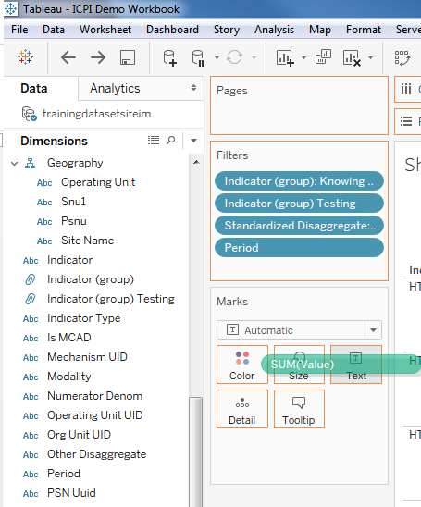
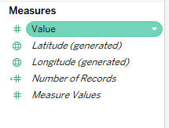
Build a basic table - 8
Check your data by dragging in dimensions you’ve set to filters, or other variables like “Numerator Denom”
Drag “values” from Measures to Text in the Marks Card

Slide 39
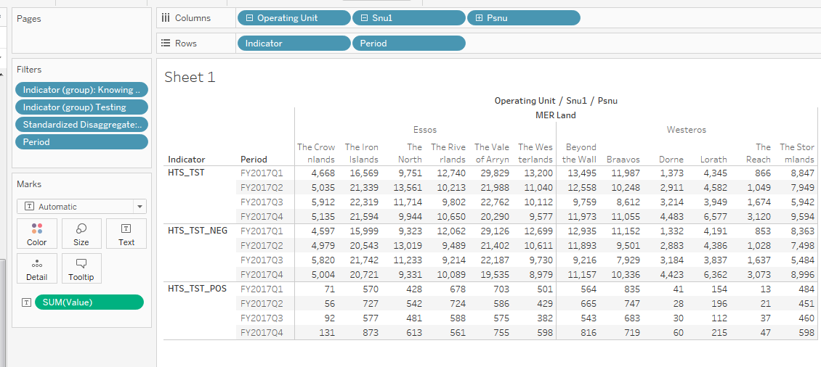
Build a basic table - 9
Check your view

Slide 40
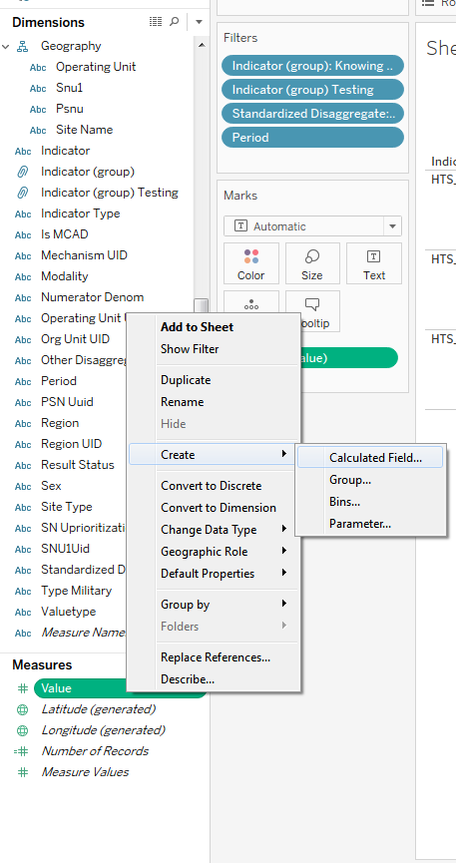
Build a basic table - 10
Create Measures to Calculate Yield

Slide 41
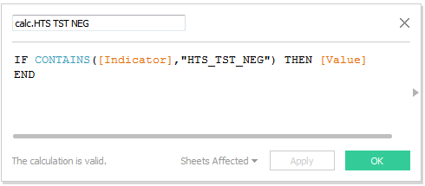
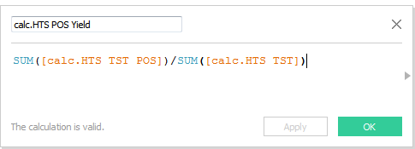



Build a basic table - Calculating Yield
Create Calculated Measures

Slide 42

Build a basic table

Slide 43

Build a basic table

Slide 44

Create a bar chart

Slide 47
Section timing = 20min

Slide 48
Resources
Tips for Using MER Structured Datasets with Tableau
Code for reshaping MER Structured Datasets
Tableau users slack group

Slide 49


Questions & Discussion

Slide 50
Section timing = 15min

Slide 51
Training Survey

